Slide 1
Do Not Overpay for Fault Tolerance
Edo Roth Andreas Haeberlen
University of Pennsylvania

Slide 2

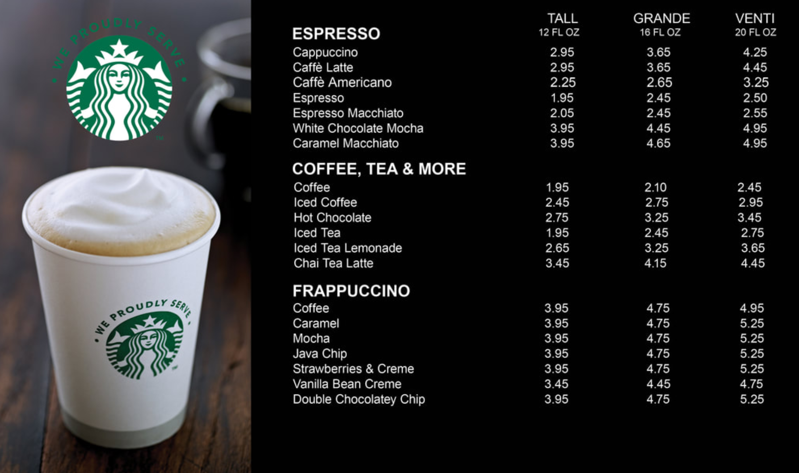
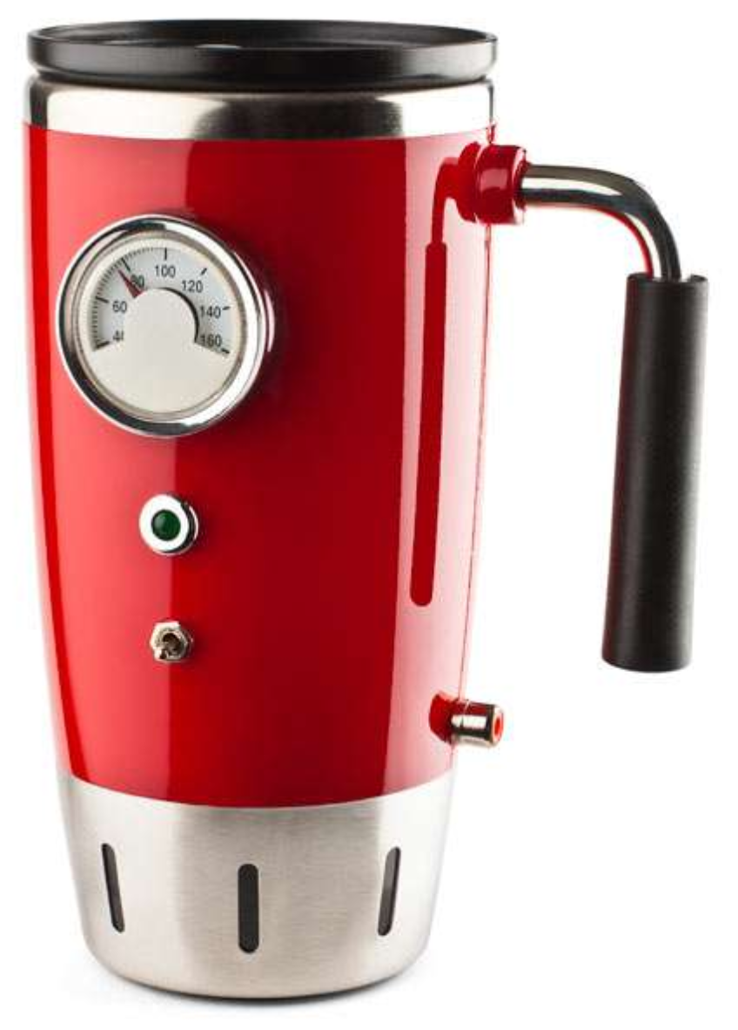
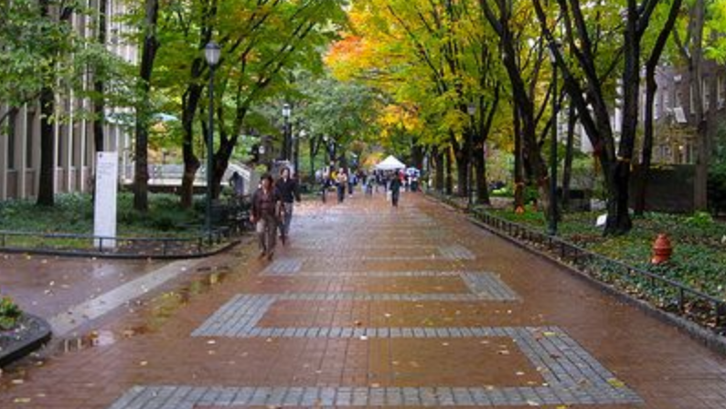
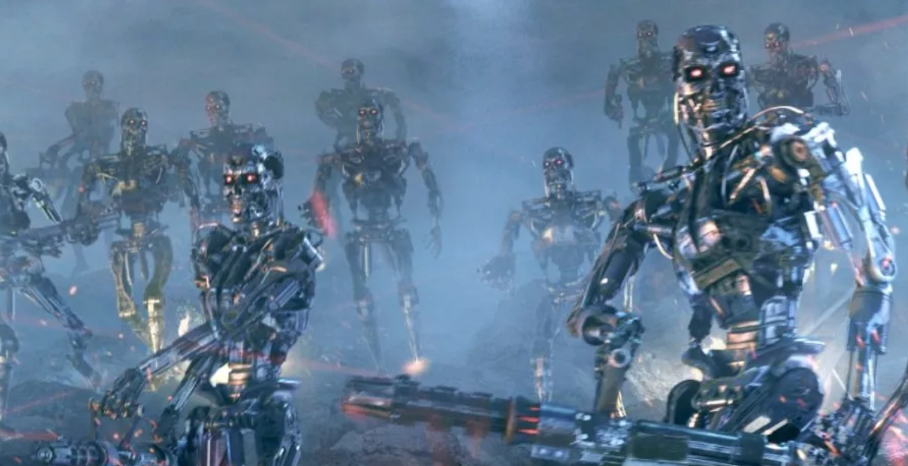
Do not overpay for your coffee!
Titanium cup
Iris scanner
Self-destruct button
$1,099.95
Paper cup
$7.99
Espresso Battaglia
1,099.95
2,299.95
3,599.95
What if your favorite coffee shop had these options?
  If you get the $1,099.95 Battlefield Special but aren't actually going into battle today, you are overpaying for your coffee!

Slide 3
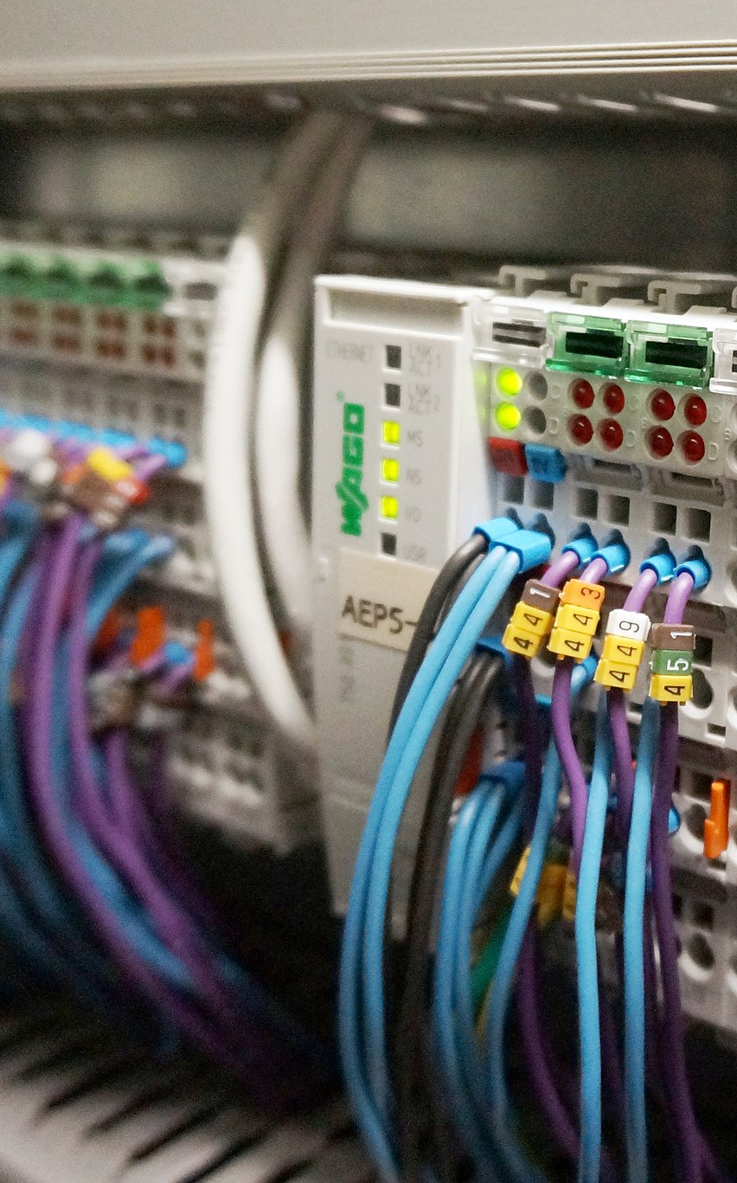
Do not overpay for fault tolerance!
STATE-MACHINE REPLICATION Tall Grande Venti
Do nothing 0.00 0.00 0.00
Simple backup 0.99 1.99 2.99
Paxos 2.99 3.99 4.99
PBFT 5.99 7.99 9.99
CONSENSUS
Flooding 0.55 0.75 0.95
Trusted hardware 1.95 2.95 3.95
EIG trees 4.95 6.95 9.95
We argue that the situation in fault tolerance is similar
  Some solutions are more powerful/general/pessimistic than what we really need
  Real-time systems in particular have some really attractive options
  The "price tags" can differ a LOT – sometimes by several orders of magnitude!

Slide 4
Our contributions
We look at the design space for consensus
  Reputation for being extremely difficult to solve
  This is true – but only for a certain "corner" of the space!
  The rest has solutions that are MUCH simpler!
We also cover two case studies
  "Real-time Replica Consistency over Ethernet with Reliability Bounds" (RTAS'20)
  "RT-ByzCast: Byzantine-Resilient Real-Time Reliable Broadcast" (Trans. Comp.'19)
I will show you an alternative solution for the first one that is:
  Much simpler
  A lot more reliable
  Orders of magnitude cheaper
Really
hard
Easy
Hard

Slide 5
Outline
Overview
Design space
Case study
Conclusion
NEXT

Slide 6
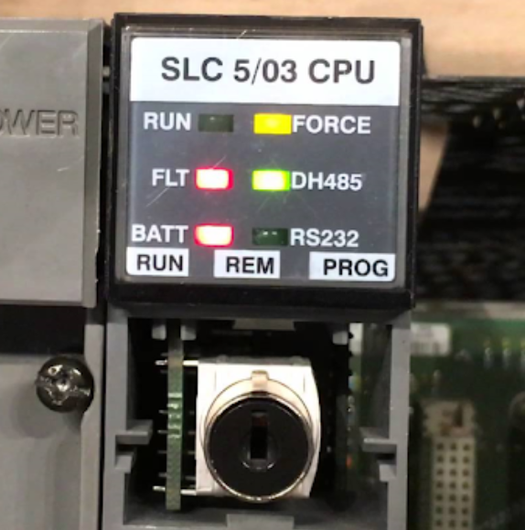
Faults in embedded systems
Lots of things can go wrong in an
embedded system
  Computation error
  Packet corruption
  Packet loss
  ...
We do need fault tolerance!
Not all faults are crash faults!
  Crash faults would mean that a faulty node just stops
  We need something that can tolerate non-crash faults

Slide 7


Let's assume Byzantine faults!
Faults from
the previous
slide
Byzantine
faults
All
faults
Crash
faults
Interesting candidate: The Byzantine model
  Assumes that a faulty node can do (almost) anything!
  Includes all of the faults from the previous slide
Safe choice! Why not tolerate Byzantine faults?

Slide 8
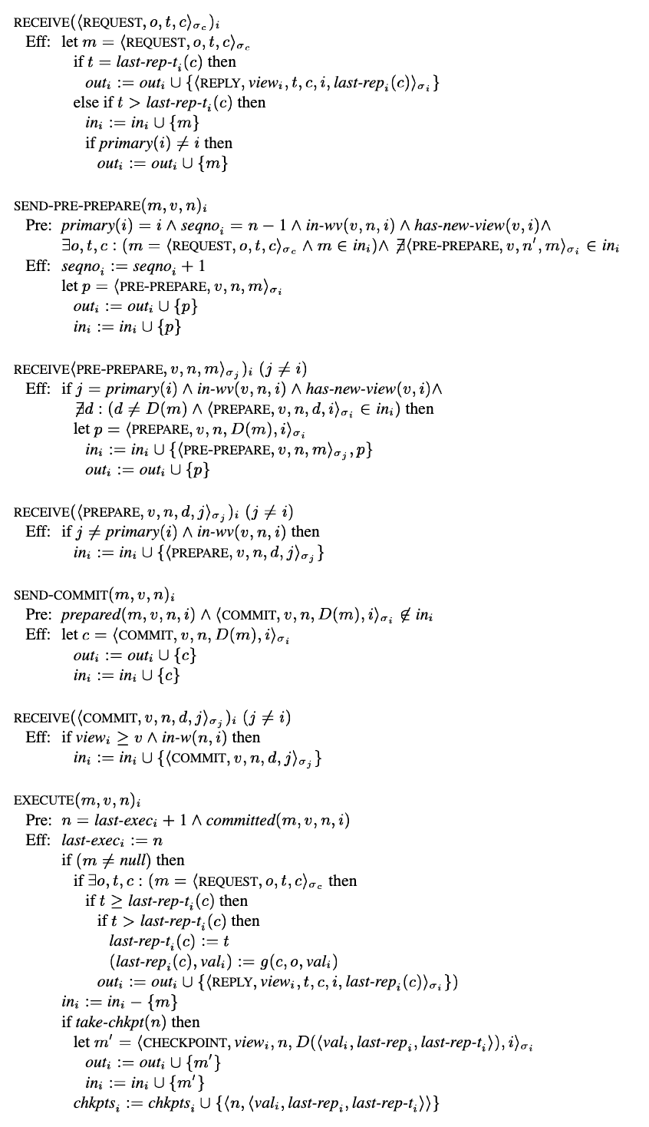
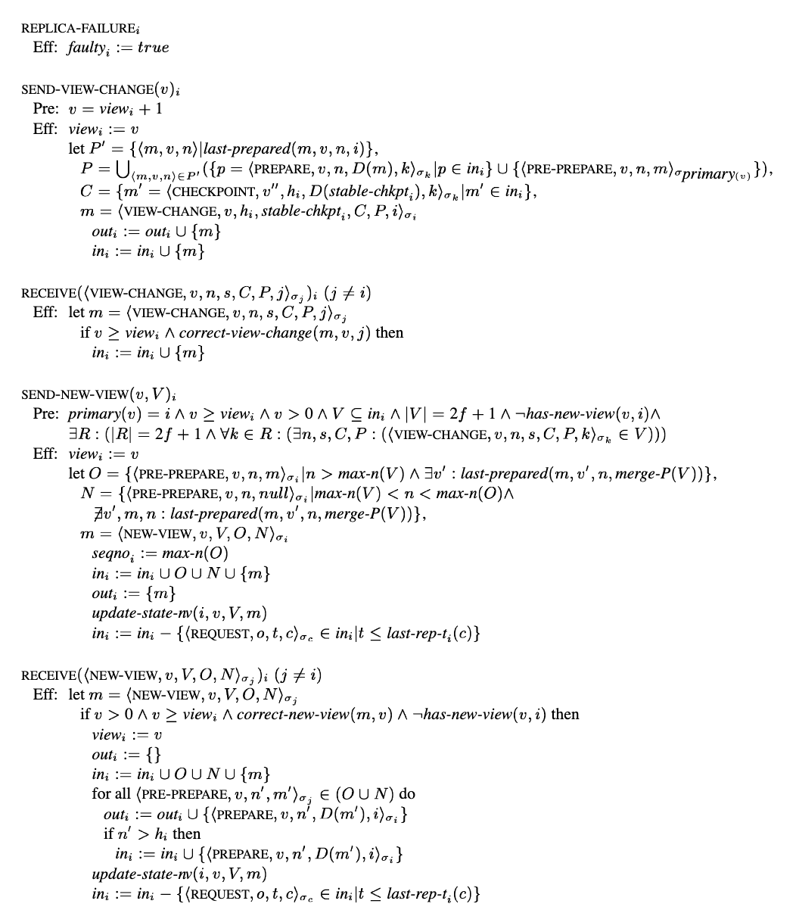
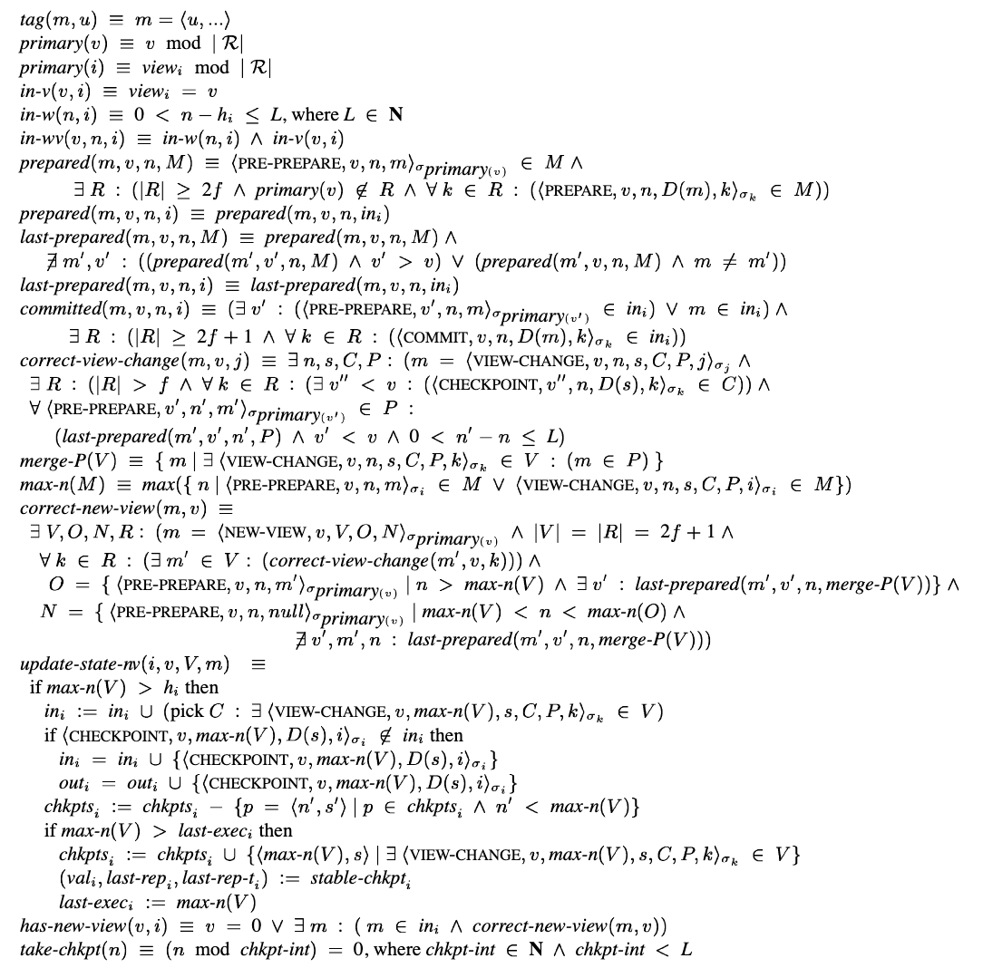
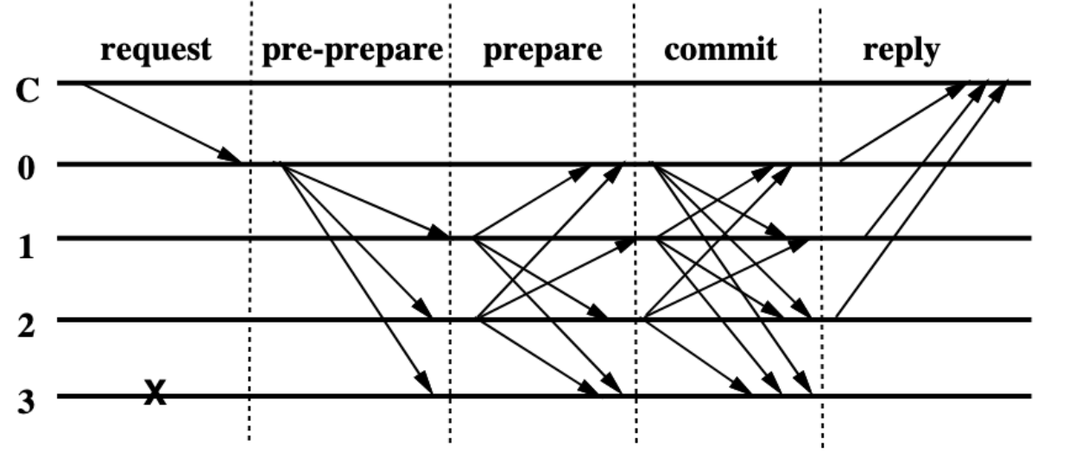
Tolerating Byzantine faults is hard!
Problem: Most Byzantine-tolerant algorithms
  ... are very complex
  ... have a considerable overhead
  ... require fairly strong assumptions (e.g., N>3f)
Sounds like awfully hard work for packet corruptions, etc.

Slide 9
Why is this so difficult?
Random
corruption
Adversarial
behavior
All
faults
Byzantine
faults
Crash
faults
Not all Byzantine faults are equally hard!
  If a faulty node can do "anything", it could also tell lies, attack other nodes, ...
  We can think of a faulty node as being controlled by a malicious adversary
  The faults I discussed earlier (random corruption) are not like this!

Slide 10
What can we do about random corruption?
Suppose we do not need 'perfect' reliability
  Example: We can tolerate a failure probability of 10⁻¹⁸
And suppose faults occur randomly, not adversarially
Then most faults are very easy to handle!
  Random packet loss: Send a few identical copies of each packet
  Random packet corruption: Include a hash in each packet; drop if hash does not match contents
  CPUs make random errors: Repeat computations a few times
  (e.g., with ASC – Correia et al., ATC'12)
For more information about these techniques, please see our paper!

Slide 11
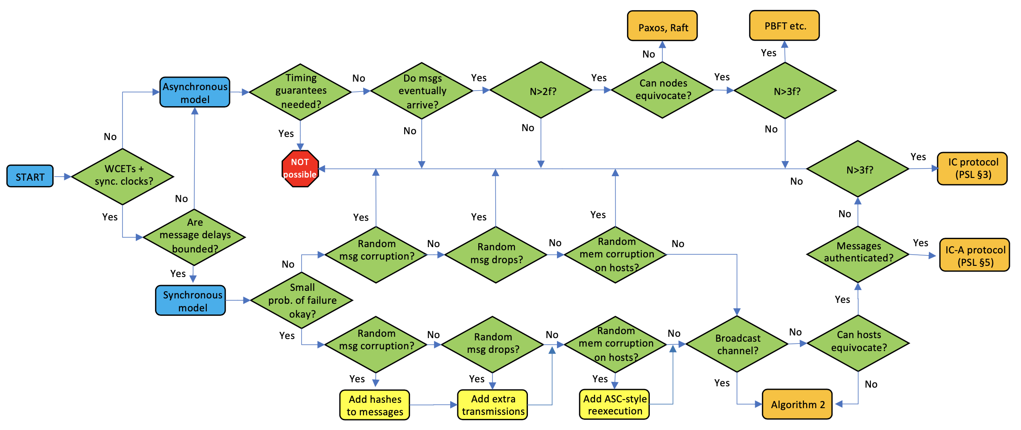
Example: Fault-tolerant consensus
Pretty hard (asynchronous)
Very hard
(adversarial)
Fairly easy
(synchronous+benign)
More about the design space for consensus is in the paper
  It is mostly the adversarial scenarios that require lots of complexity
  A lot of scenarios are 'easy' – especially with synchrony, which is common in RT!

Slide 12
Outline
Overview
Design space
Case study
Conclusion
NEXT

Slide 13

GBB overview
Our first case study was a paper from RTAS'20:
  "Real-time Replica Consistency over Ethernet with Reliability Bounds"
  by Gujarati, Bozhko and Brandenburg ("GBB")
This paper looks at the following problem:
  Each node has a local input and must decide on a value
  Strong correctness: If a majority of the nodes has the same
  local input v, then a majority of the nodes must decide on v
The paper mostly discusses random corruptions, but assumes the Byzantine model
Majority
decides on B
A
B
B
B
A
B
Majority has
input B

Slide 14
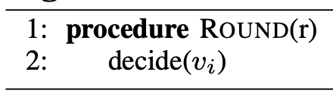
Problems with the definition
Got B
Got A
Got B
Got A
Strong correctness: If a majority of the nodes has the same local input v, then a majority of the nodes must decide on v
A
A
B
B
A
B
With Byzantine faults, problem statements become subtle
If faults are really Byzantine, the problem has no solution!
  Adversarial nodes could have input A, but act as if they had input B
  Proofs of impossibility (also for weak correctness) are in the paper
If faults are actually benign, we can simply do nothing!
  If nodes don't lie, they can just decide on their local input
  The goal presumably was for the correct nodes to decide
  on the same value (which we assume going forward)

Slide 15
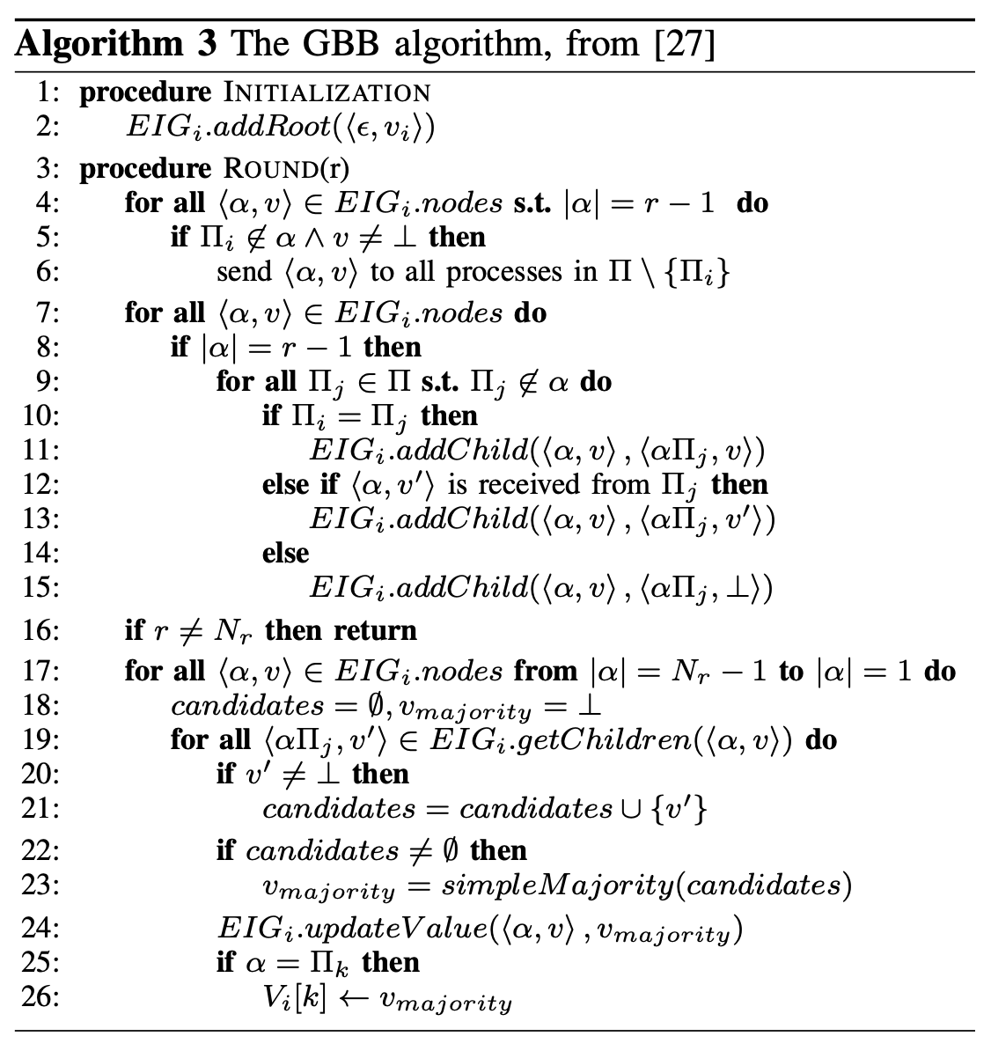
GBB's solution
N₁:
Input A
N₂: N₁:
Input A
N₃: N₁:
Input A
N₄: N₁:
Input A
N₃:N₂:N₁:
Input A
N₄:N₂:N₁:
Input A
N₂:N₃:N₁:
Input A
N₄:N₃:N₁:
Input A
N₂:N₄:N₁:
Input A
N₃:N₄:N₁:
Input A
GBB's solution: a variant of EIG trees
  Byzantine-tolerant, synchronous algorithm
  In each round, each node tells the others
  what it has heard in the previous round
  Requires N>3f

Slide 16
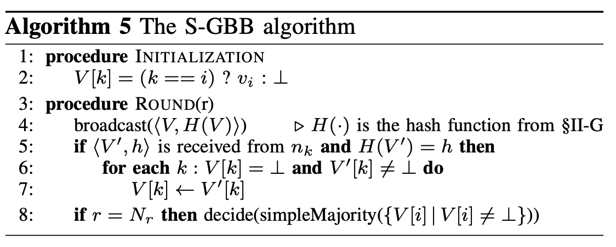
Our solution: S-GBB
Round 1
Round 2
Round 1
(0,⏊,⏊)
(0,1,⏊)
(0,1,1)
1
A
(⏊,1,⏊)
(0,1,1)
(0,1,1)
1
B
(⏊,⏊,1)
(0,⏊,1)
(0,1,1)
1
C
Time
Much simpler
than GBB!
Our proposed alternative: S-GBB
  Each node maintains a vector V with what it thinks the others' inputs are
  In each round, it uses a link-layer broadcast to send V to the other nodes
    A hash value is included to detect packet corruption whp (false negatives: 6.8*10⁻⁴⁹ for SHA-1)
  The other nodes update their local vector based on what they receive
    ASC is used to mask computation errors (not shown in the pseudocode)
  At the end, each node decides on the majority value in its vector V

Slide 17
Evaluation: Overhead
10³
10⁴
GBB (R=4)
GBB (R=2)
S-GBB (R=4)
S-GBB (R=2)
GBB (R=4)
GBB (R=2)
S-GBB
1,100 values
10³
10²
Total values sent
(per node per destination)
10²
Values stored (per node)
10¹
10¹
8 values
2
3
4
5
6
7
8
9
10
1
2
3
4
5
6
7
8
9
10
Number of nodes (N)
Number of nodes (N)
Comparison: Communication+storage, for different #rounds
  GBB stores the entire EIG tree, and sends one level in each round
  S-GBB stores just one value for each node, sends one vector in each round
S-GBB is much cheaper than GBB

Slide 18
Evaluation: Reliability
10⁻²
10⁻⁴
10⁻⁶
10⁻⁸
p_{hostcorrupt}=10⁻⁵
p_{netcorrupt}=10⁻³
p_{crash}=10⁻⁸
Lower is better
10⁻¹⁰
Failure probability
10⁻¹²
10⁻¹⁴
GBB (R=2)
GBB (R=1)
S-GBB (R=2)
S-GBB (R=1)
10⁻¹⁶
10⁻¹⁸
3
4
5
6
Number of nodes
Comparison: Probability of violating strong correctness
S-GBB is more (!) reliable than GBB
  GBB's assumption (N>3f) does not necessarily hold
  With GBB, host corruption can flip a close majority the wrong way

Slide 19
Summary
Fault tolerance is important
But there is usually an entire menu of possible solutions
  Costs can vary by several orders of magnitude
  Seemingly innocent decisions can have a huge impact
Real-time systems offer lots of interesting opportunities
  For instance, synchrony can make things a lot simpler and cheaper
  Only a small corner of the design space is "really" hard
Don't overpay for your fault tolerance!
Thank you!

