Slide 1
Metaverse as a Service: Megascale Social 3D on the Cloud
Andreas Haeberlen
Linh Thi Xuan Phan Morgan McGuire October 31, 2023

Slide 2
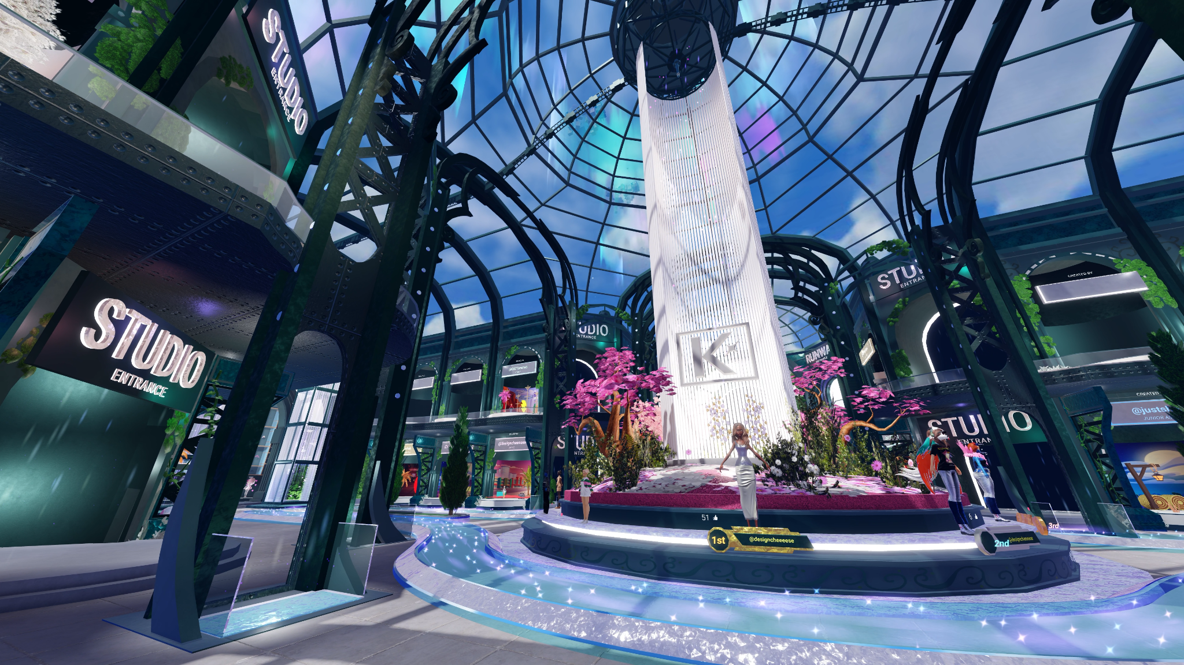
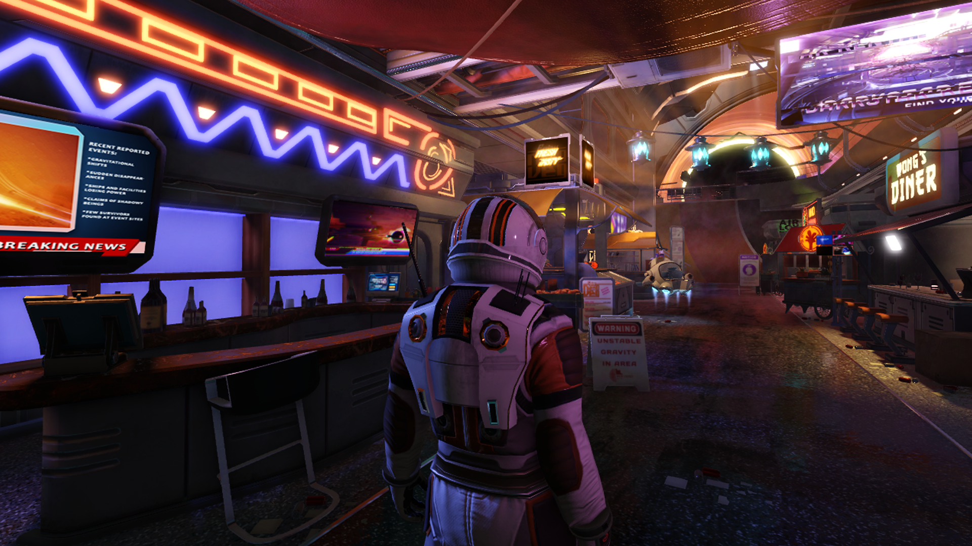
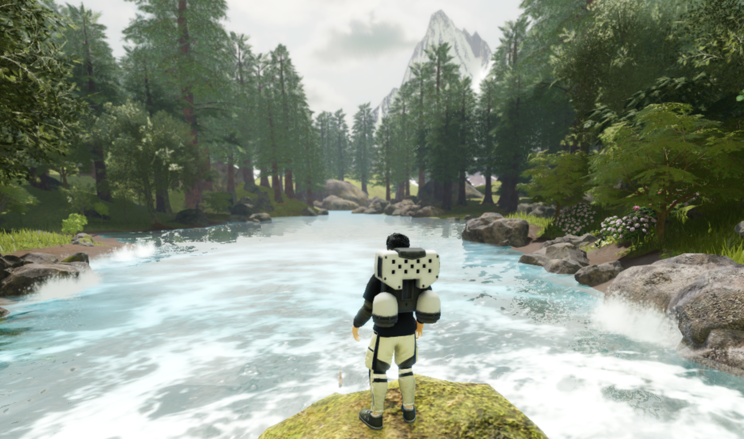
Is the metaverse already here?
“Snow Crash” describes a giant, immersive virtual world called the Metaverse
Roblox, Minecraft, Fortnite, Second Life, … offer very similar worlds today
They have millions of users!
“Hiro is approaching the Street. It is the Broadway, the Champs Élysées of the Metaverse. […] It does not really exist. But right now, millions of people are walking up and down it.”

Slide 3
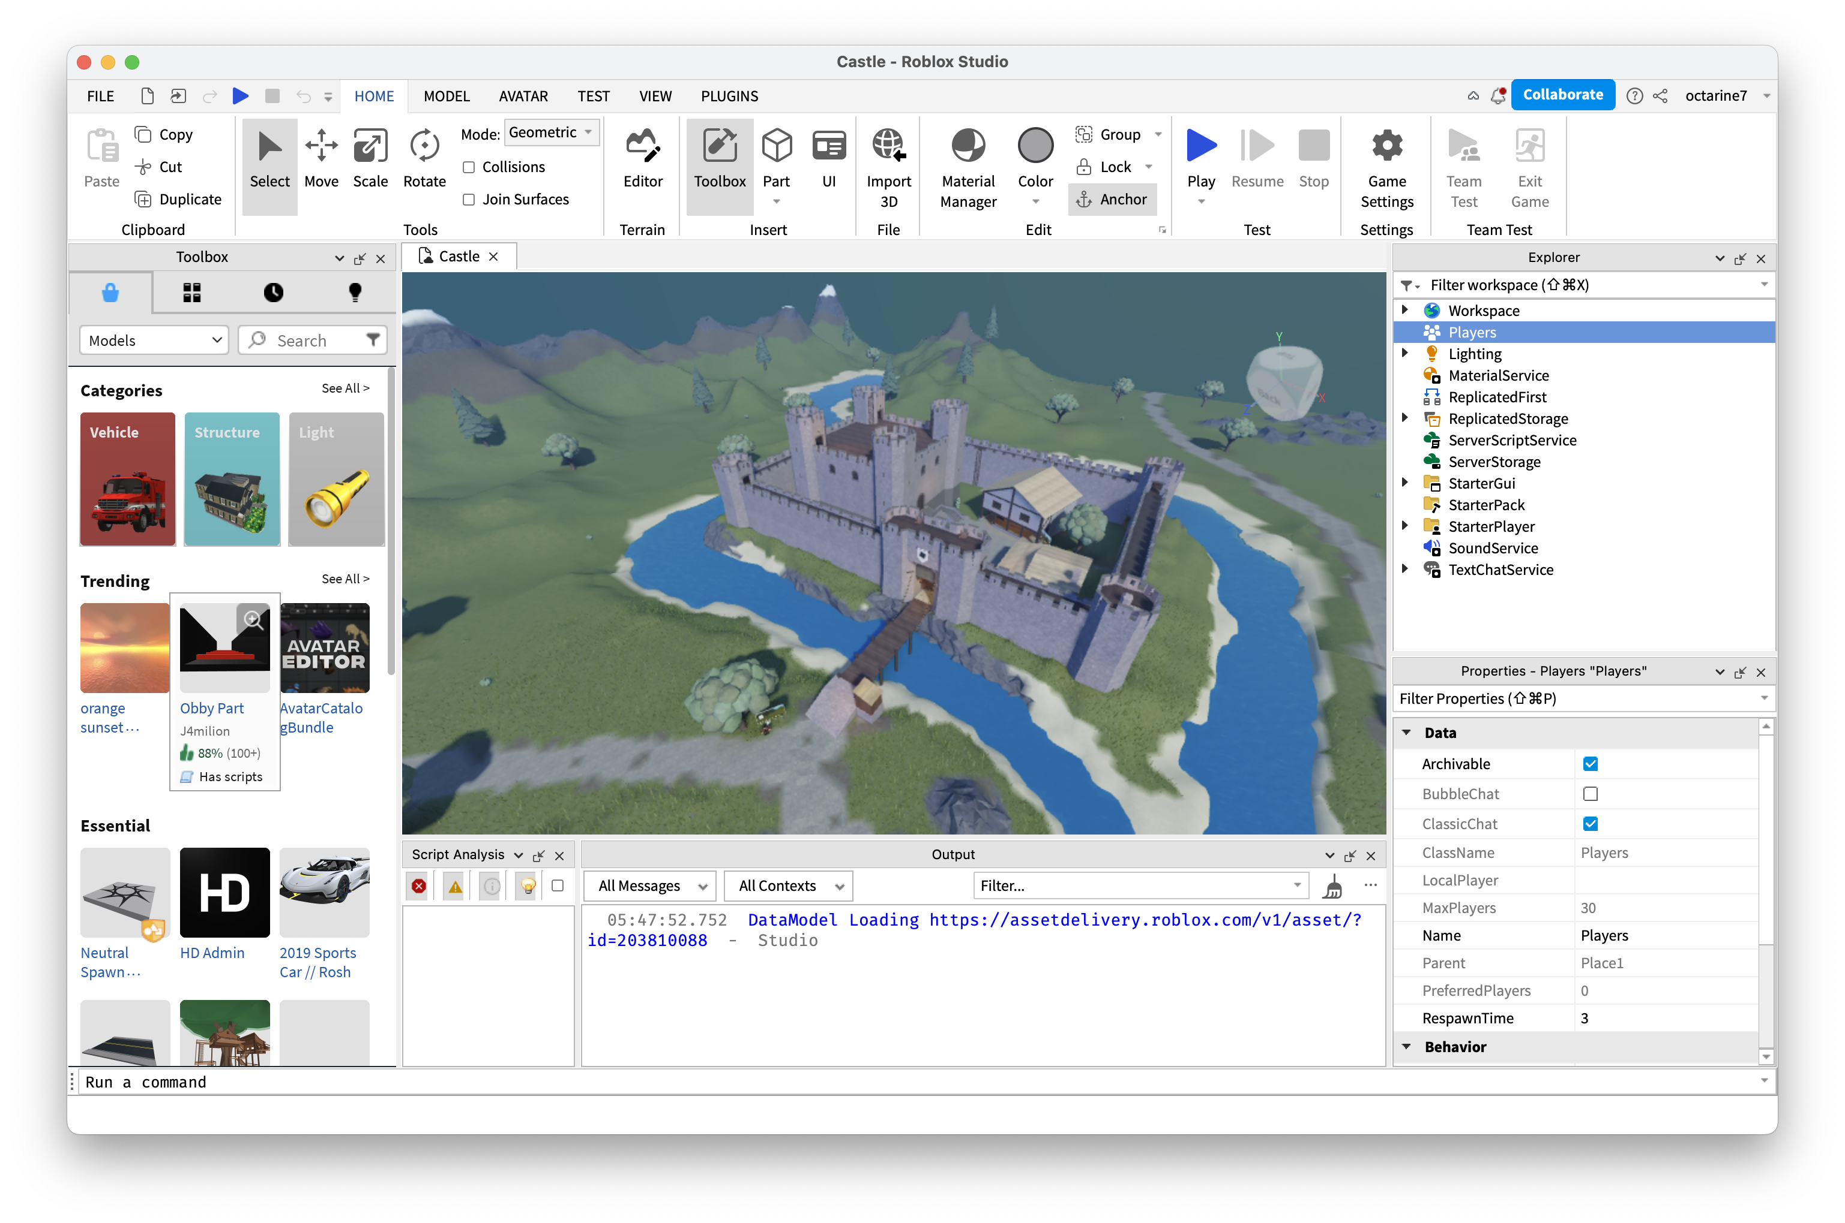
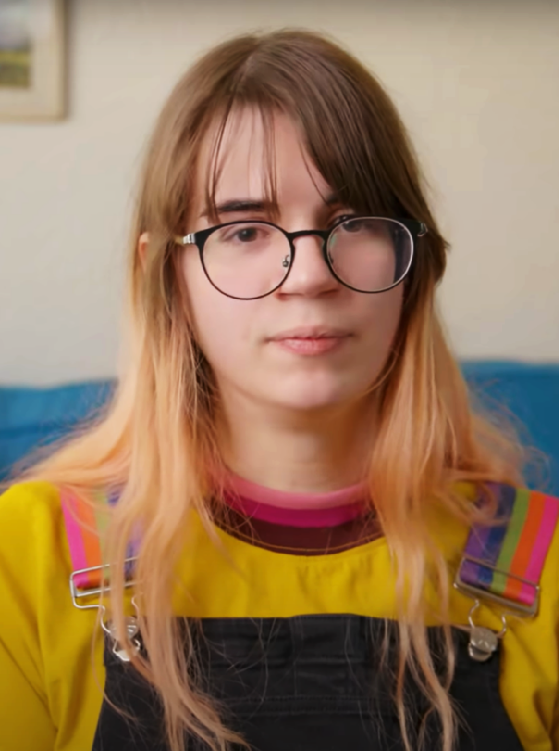
A closer look
Users
Creators (Roblox: 3M)
Experiences (Roblox: 5.6M active)
Platform
Players (Roblox: 65.5M daily)
Anyone can build a virtual world (“experience”)
Platform has a large resource pool + broad network access
Elastic provisioning when players join an experience
This almost sounds like a cloud service!
+ upload it to a publicly accessible platform

Slide 4
Bad news: Virtual Worlds Are Difficult To Scale!
~700 players
~400 players
~100 players
~100 players
~20 players
As of today, virtual worlds are difficult to scale beyond a few hundred players!
Every current platform has architectural limits
But what about millions of players??
Players are grouped into ‘instances’ of a few hundred players each
This is a known, famously challenging problem!
If this is true, can we ever get a ‘real’ metaverse?

Slide 5
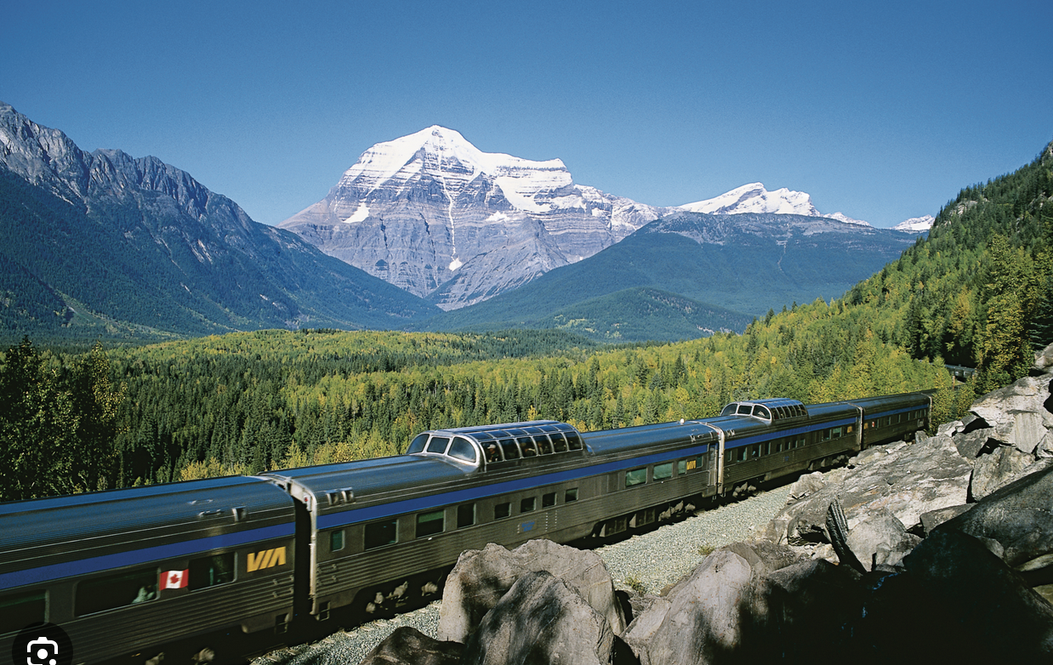
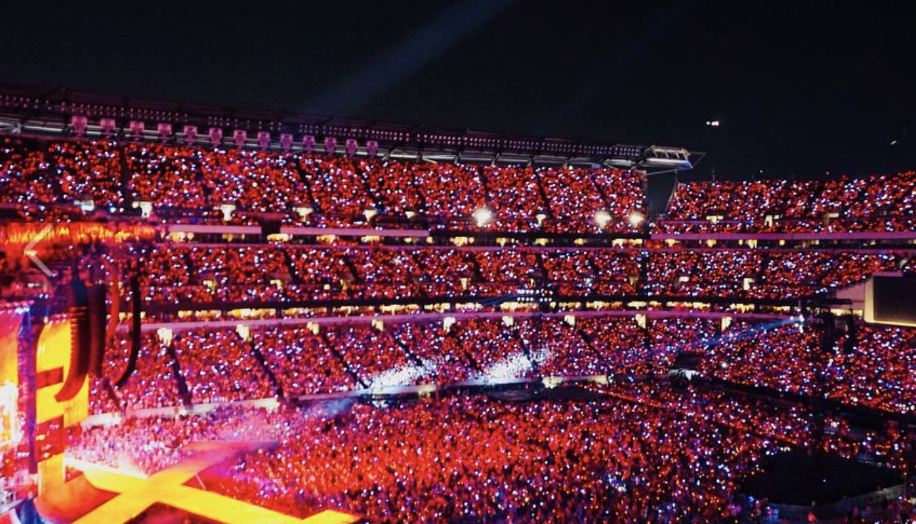
Our vision: Megascale virtual worlds
Can we build megascale virtual worlds, such as:
A concert with 50,000 avatars in the audience
An 18th century naval battle
A large passenger train in the mountains
An entire city?

Slide 6
How can we get there?
Scaling virtual worlds is a (really cool) Systems problem
At first, this may sound like a graphics/game/… problem
But in fact, many of the key challenges are systems challenges!
This could be a really exciting problem for our community to work on!

Slide 7
Outline
In the rest of this talk, I will try to convince you that this is true!
Key challenges:
Workload scalability
Distributed execution
Partitioning
Consistency
Load balancing
Synchrony
Speculation
Security
Concurrency
Reconciliation
Efficiency
Scheduling
In the paper
In the paper

Slide 8
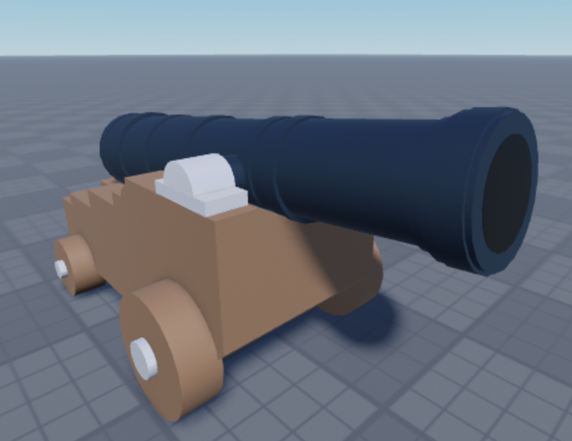
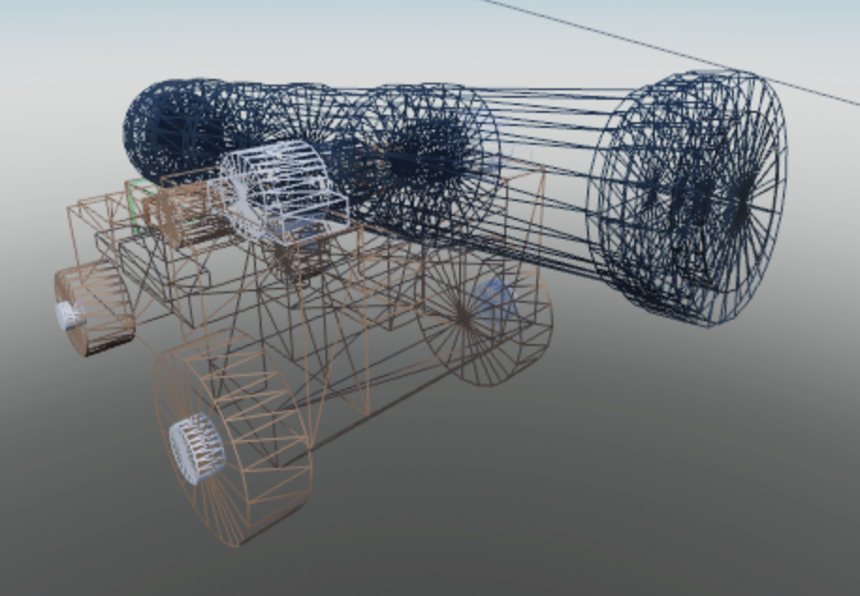
Background on virtual worlds (1/2)
Workspace.Switch.Touched:Connect(function(x)
local cannon = Workspace.Cannon
local player = x.Parent:FindFirstChild("Humanoid")
local fired = cannon:FindFirstChild("Ball")
if player and not fired then
local ball = Instance.new("Part")
ball.Name = "Ball"
ball.Shape = Enum.PartType.Ball
ball.Position=cannon.Position+Vector3.new(0,6,0)
ball.Parent = cannon
ball:ApplyImpulse(Vector3.new(200,700,200))
end
end)
At a high level, experiences consist of 3D objects and scripts
Objects have properties (position, velocity, texture, weight, …)
Scripts can influence properties through a DOM-like “data model”
At runtime, properties are evolved by the physics module
Result: Once fired, cannonball moves on a ballistic trajectory

Slide 9
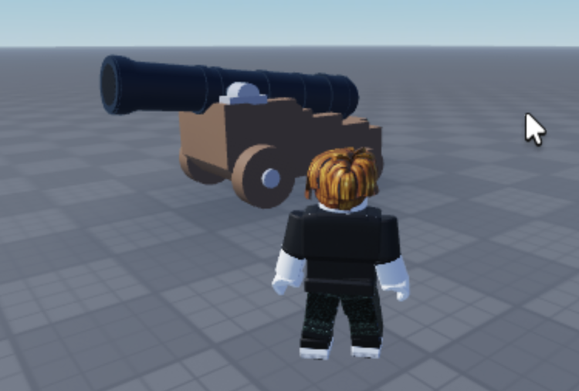
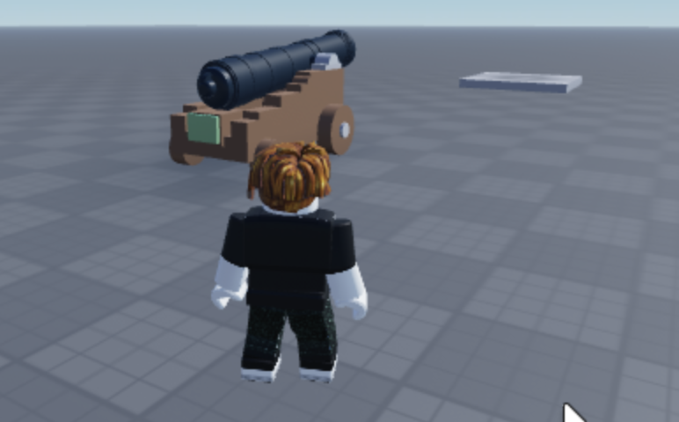
Background on virtual worlds (2/2)
LOGIC
Edge servers
PHYSICS
AUDIO
SHADOWS
LIGHTING
Internet
LOGIC
LOGIC
PHYSICS
AUDIO
PHYSICS
AUDIO
SHADOWS
LIGHTING
SHADOWS
LIGHTING
FRAME
FRAME
Client #1
Client #2
System consists of a simulation and a renderer
Simulation maintains + evolves the state of the virtual world
Renderer shows each player a current view of this world
World state is synchronized over the network
Notice: Strict timing requirements (60fps!!), heavily distributed

Slide 10
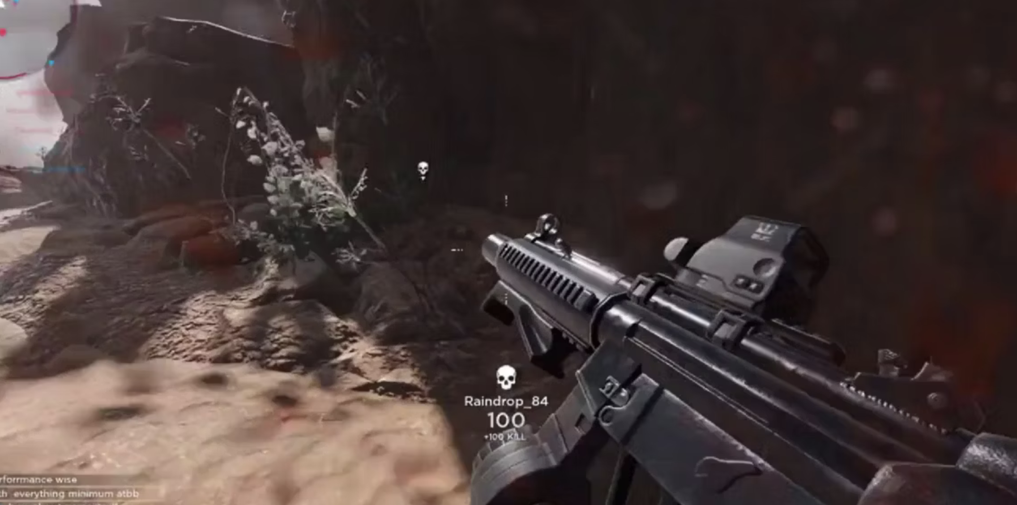
Can virtual worlds scale at all?
2D space
Why do (basic) KVS workloads scale so well?
No dependencies – keys are independent!
What about virtual worlds?
Physics: Any object can depend on any other
Theoretically yes (e.g., collisions)! → O(N²)?
In practice, short-range effects → spatial locality
Scripting: Any script can access any (and every) object
Examples: Raycasting, certain events, …
In practice, there is a lot of access locality here too!
Todo: Careful API revisions, picking good guarantees, …
Objects
Raycast

Slide 11
Distributed execution
2D space
Large worlds will exceed the capacity of any server
Need to distribute world across multiple servers
… and potentially some clients, too!
How do we do this?
Need to keep most of the computation local to a given server → contiguous regions
Need ability to adjust regions in response to load changes → small fixed-size pieces (“tiles”?), roughly analogous to pages in virtual memory
Todo: Special handling for boundary regions, etc.
https://www.thegamer.com/roblox-first-person-shooter-realistic-graphics/

Slide 12
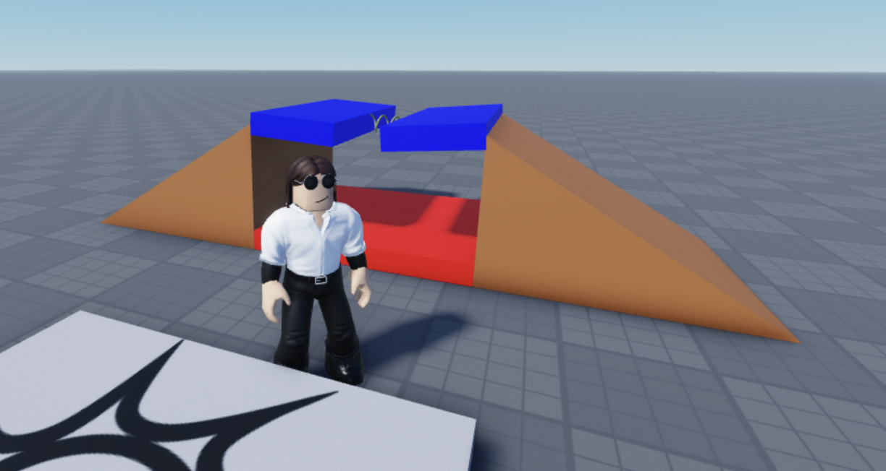
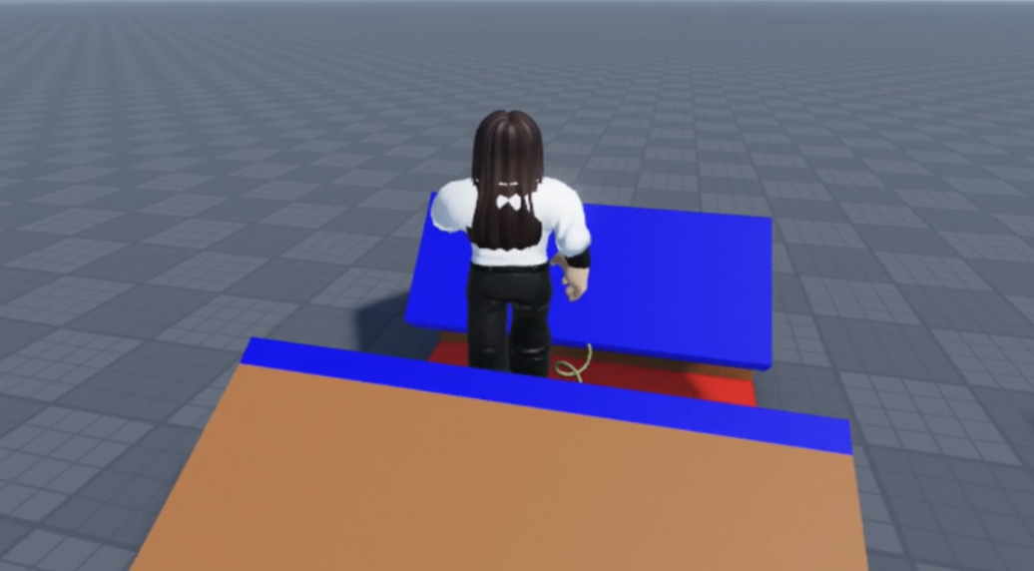
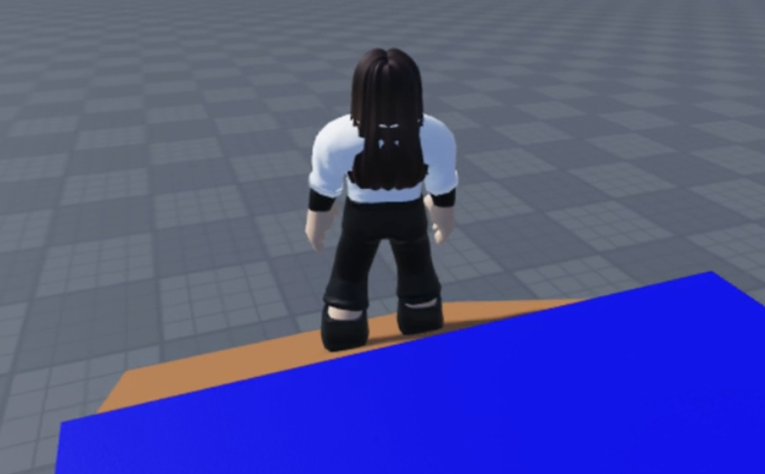
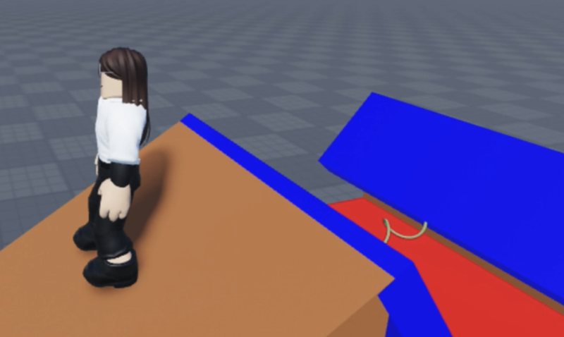
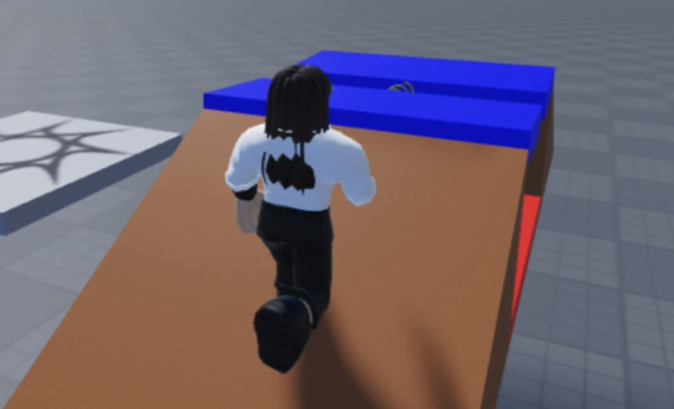
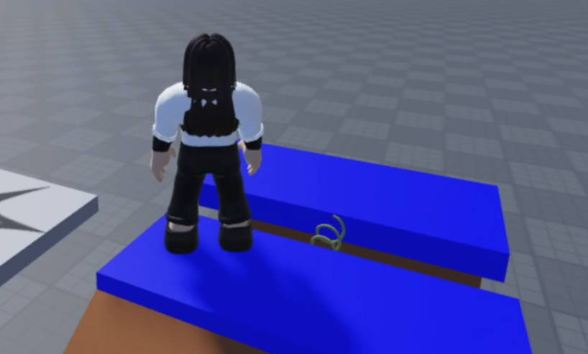
Speculation
Script
Open trapdoor
300ms
Walk
Walk
Walk
Open
Time
Speculation confirmed!
✅
Servers and clients are separated by WAN latencies
Result: Information usually arrives too late to be included in the next frame
We can mask this with speculative execution
Need more than ‘just’ dead reckoning (scripts!!)
Misspeculation → roll back, correct, roll forward?
Todo: Good speculation, efficient rollback, appropriate goals, …
https://www.thegamer.com/roblox-first-person-shooter-realistic-graphics/

Slide 13
Consistency
Alice
Move left
Bob fires weapon
Fire weapon
Alice moves left
Bob
Time
HIT
Usually, the clients will have slightly different states:
Some updates may still be in flight
Todo: What is the right consistency model?
Eventual consistency is too weak (no bounds on time or divergence)
Serializability is expensive, and (usually) unnecessarily strong
Perhaps bounded inconsistency? With special cases (“favor the shooter”)?
, FPU differences, etc.

Slide 14
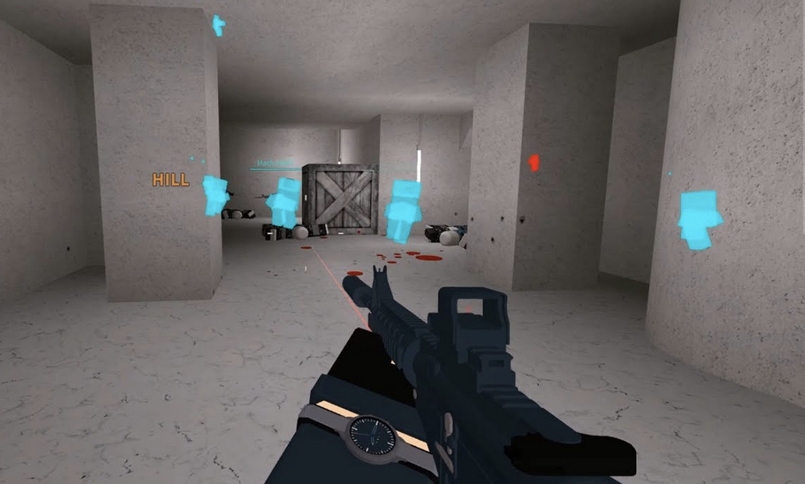
Security
Client devices need to simulate a part of the virtual world
Needed for responsiveness
Would be useful to reduce server load
A compromised device can be used for cheating
Some can be detected remotely (Example: Object injection)
… but some cannot (Example: Wall hack)
Todo: Efficient auditing, verifiable computing, ML-based plausibility checks?

Slide 15
“Systems Problems in Disguise”
At first glance, these challenges may seem unfamiliar:
Making the simulation “look plausible” to human players
Hiding WAN latencies in games with “netcode”
Deciding whether or not to count a hit in a FPS
Preventing cheating, ensuring fairness
But these are really systems problems in disguise!
All we need is some “translation”
Picking a good consistency model
Speculative execution
Reconciliation
Security
https://www.thegamer.com/roblox-first-person-shooter-realistic-graphics/

Slide 16
Summary
Virtual-world platforms are basically cloud platforms!
But they don’t currently scale to large virtual worlds!
Just many instances of small virtual worlds
This is essentially a systems problem!
Many key issues are core systems topics: security, distribution, partitioning, load balancing, scheduling, consistency, speculation, …
This could be an interesting challenge for our community to work on
… in collaboration with SIGGRAPH, GDC, RTSS/RTAS
Thank you!
https://research.roblox.com/

