Slide 1
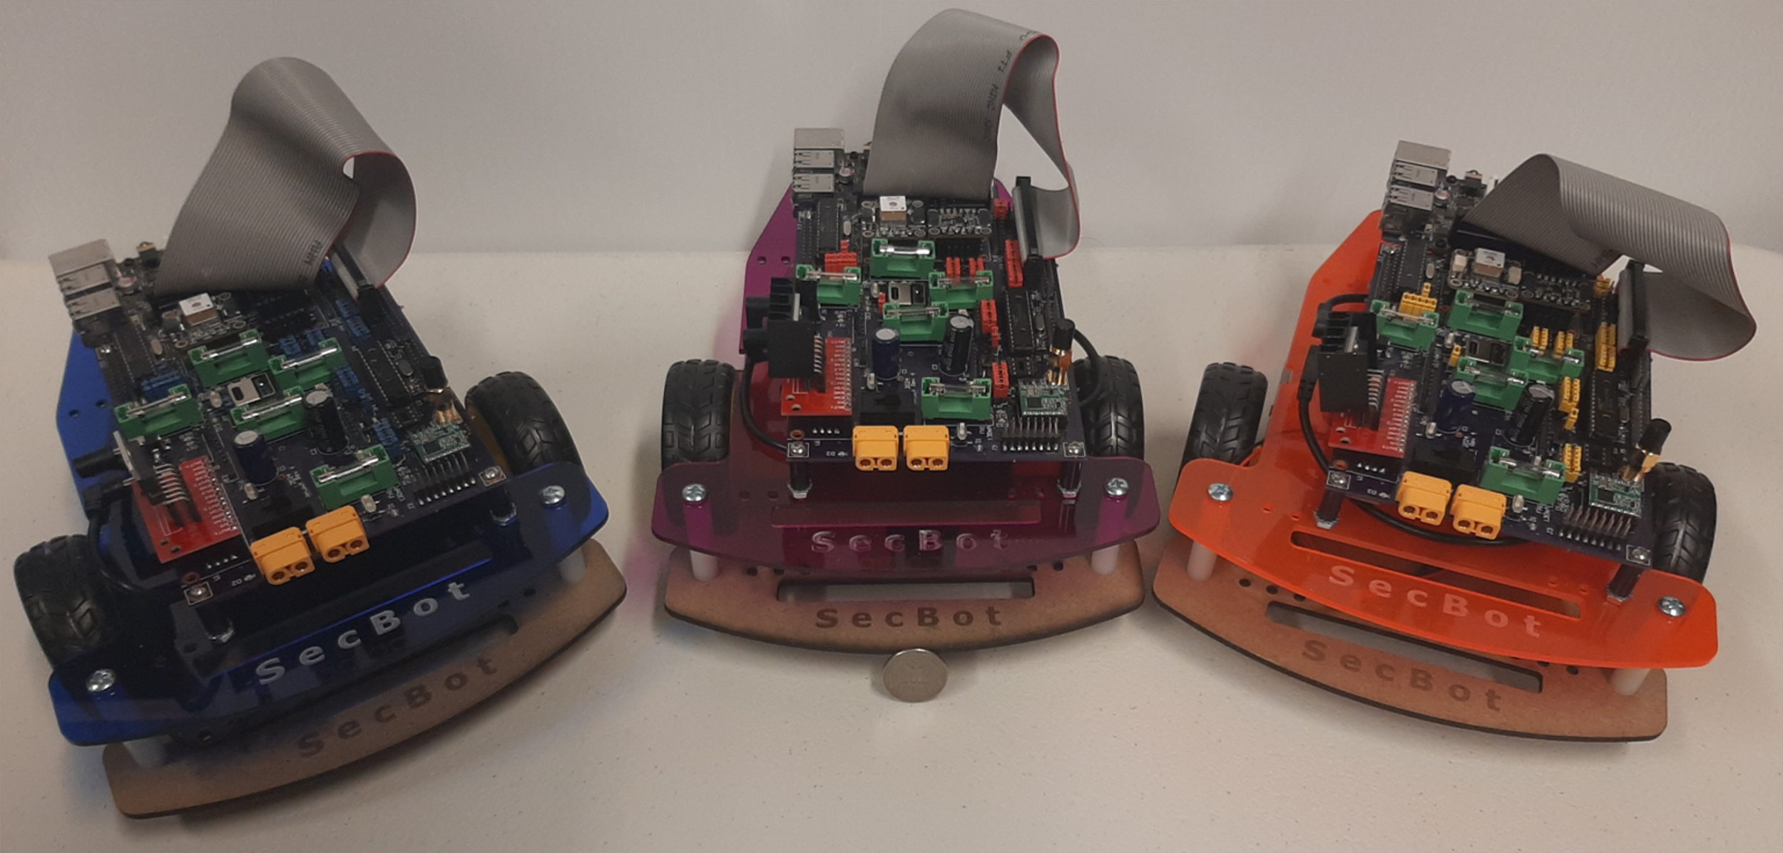
RoboRebound: Multi-Robot System Defense with Bounded-Time Interaction
Neeraj Gandhi, Yifan Cai, Andreas Haeberlen, Linh Thi Xuan Phan

Slide 2
What is a Multi-Robot System?
Ocado Warehouse
Common features
Independently mobile robots are ‘nodes’
Communication is over a dynamic, unreliable, wireless network
Wide variety of applications and environments in which systems are deployed
Hundreds of robots packing orders in grocery warehouses
Cooperating robots map outdoor setting with no GPS
Impacted industries
Logistics, agriculture, aerospace, outer space, mining, and construction, among others

Slide 3
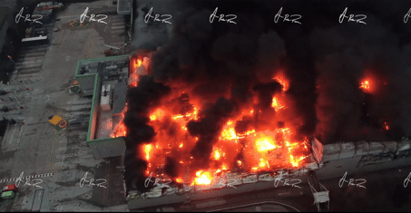
Faults Can Cause Immense Damage
Many systems susceptible to
faults that can cause this much damage!
One robot out of hundreds had a fault
and cost Ocado £100M

Slide 4
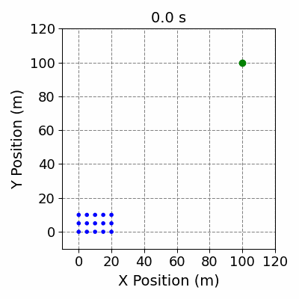
Problem Overview
With only a few robots, adversaries can disrupt entire system
Goal: Develop a technique that can, in bounded time, detect and recover from Byzantine attacks on the robots of a Multi-Robot System
No Fault
Fault with No Protection

Slide 5
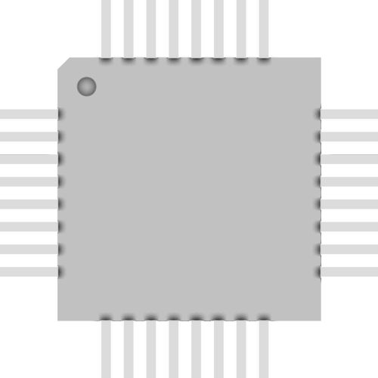
Approach
Robots audit one another’s logs
Add a tiny bit of trust to each robot
Audit
Audit
Log
Log

Slide 6
Approach
Robots audit one another’s logs
Add a tiny bit of trust to each robot
Trusted hardware enables tamper-evident logs
Audit
Audit
Log
Log

Slide 7
What is fault tolerance in mobile robots?
Challenge
Other approaches to fault tolerance exist
May not be designed for cyber-physical systems
May not be designed for dynamic, unreliable networks
Robots pose a physical threat to one another
Solution: Bounded-time interaction (BTI)
A faulty robot can only interact with other robots for bounded-time before it is put into “Safe Mode”

Slide 8
Sensors and actuators are local to the robot
Challenge
Only the on-robot compute node has access to the robot’s sensors and actuators
Threat: A faulty compute node can manipulate sensor data and control vectors
Solution: Tiny, trusted nodes ensure auditability of all messages, including sensor data and control vectors
TrInc [NSDI’09] showed that small trusted hardware can be used to:
Create tamper-evident logs of messages
Reduce communication overheads

Slide 9
Outline
Problem & Challenges
Solution Sketch
Design
Evaluation

Slide 10
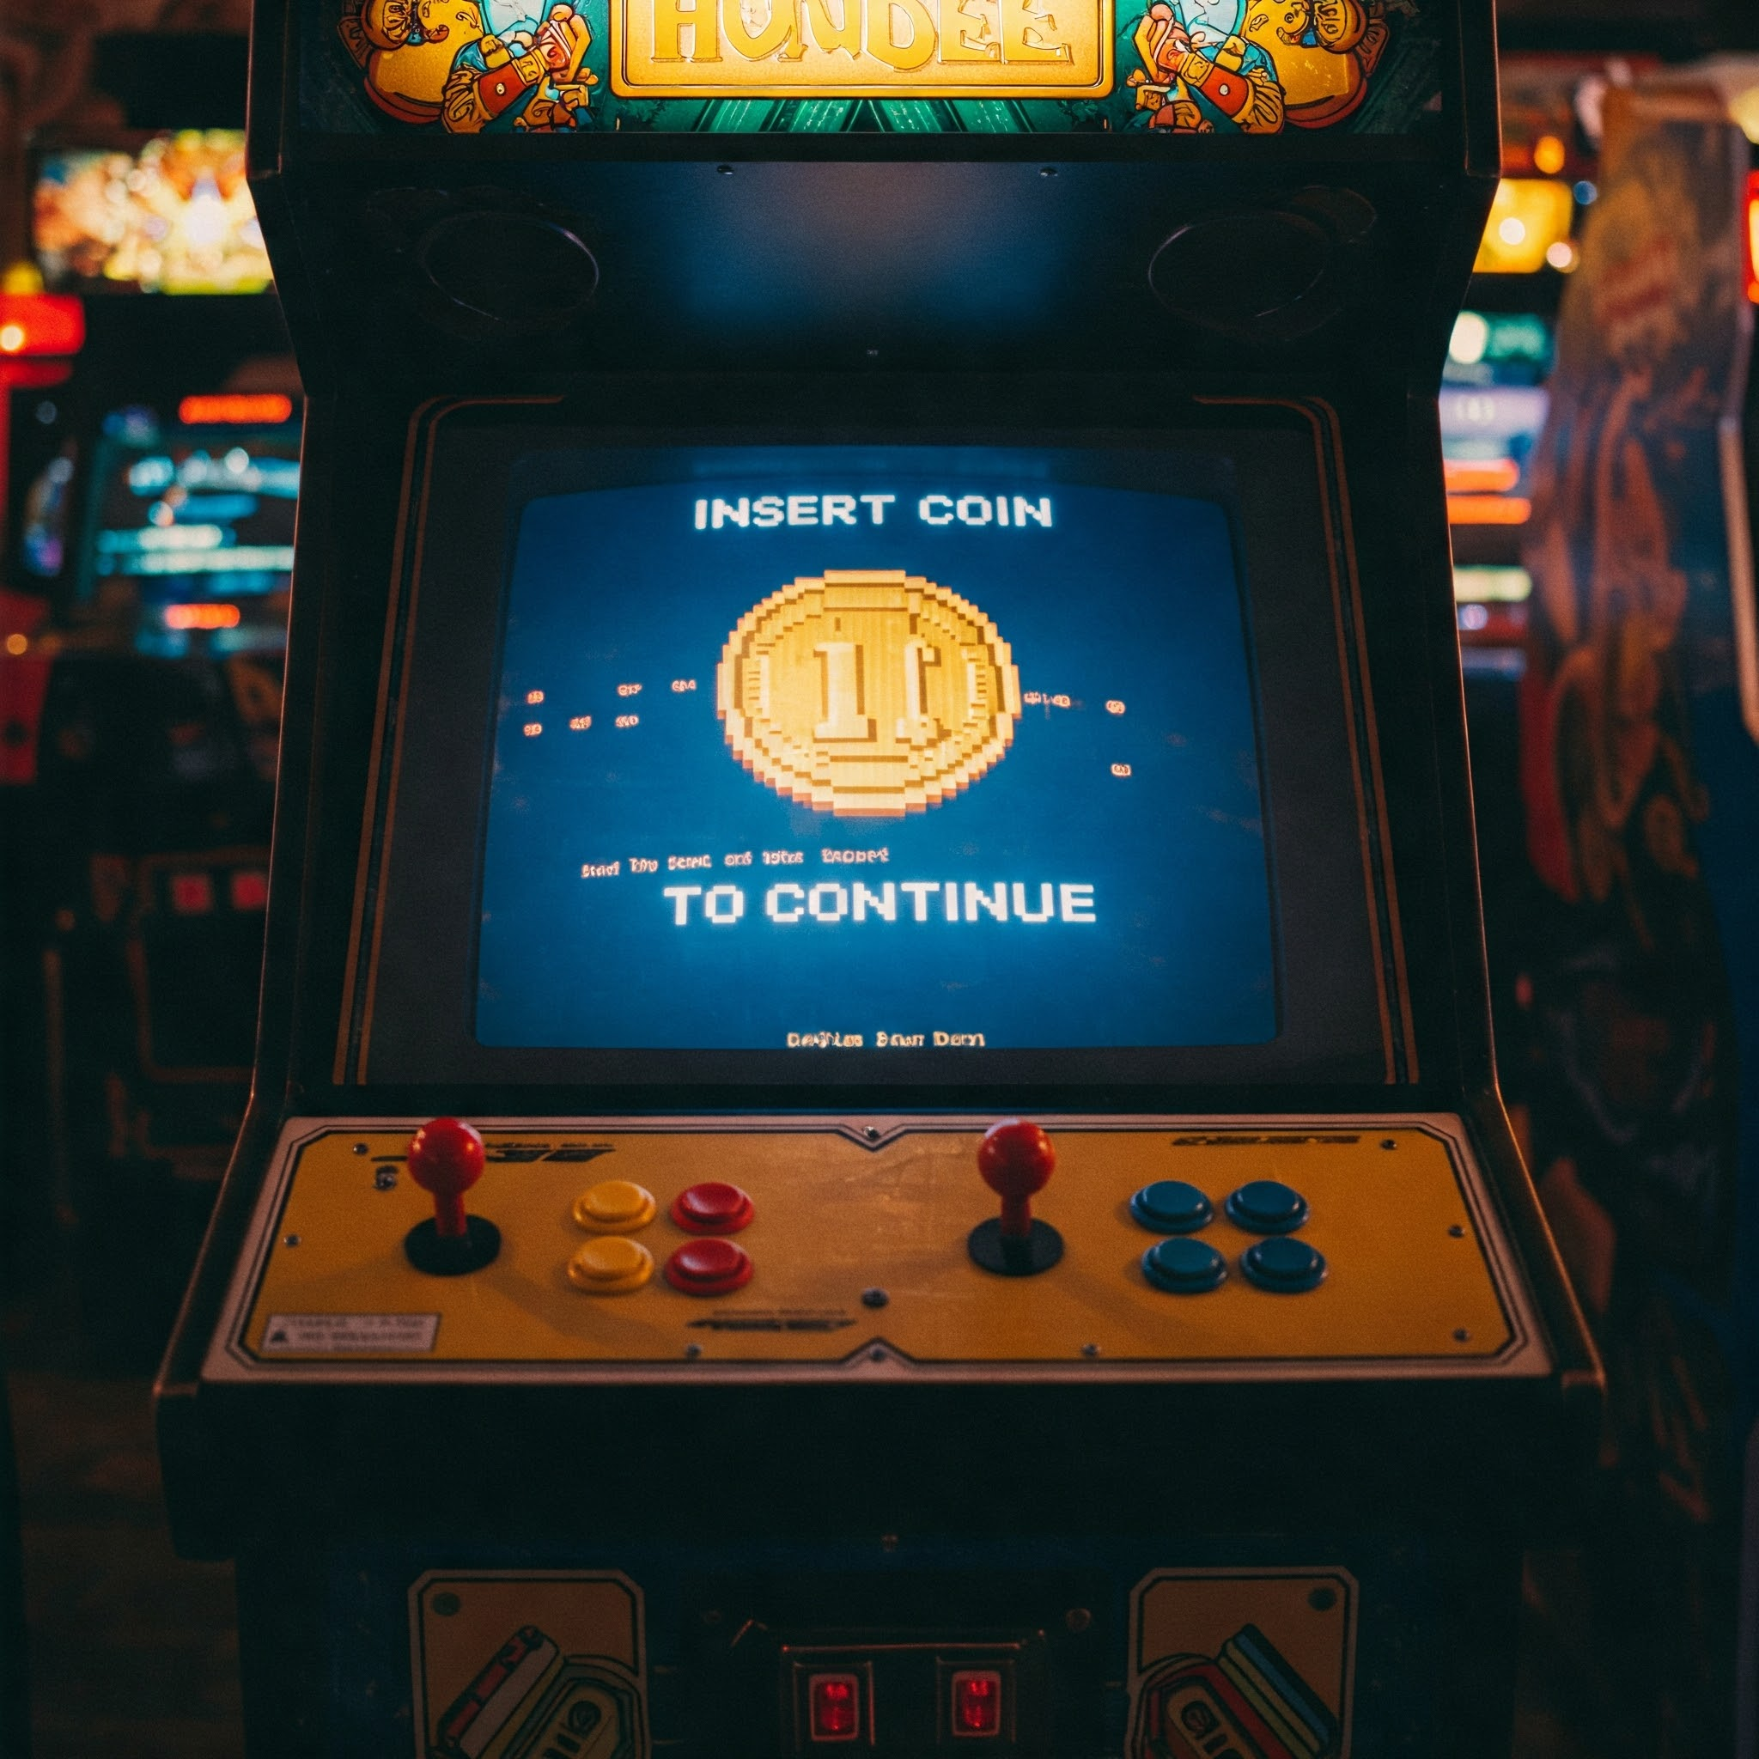
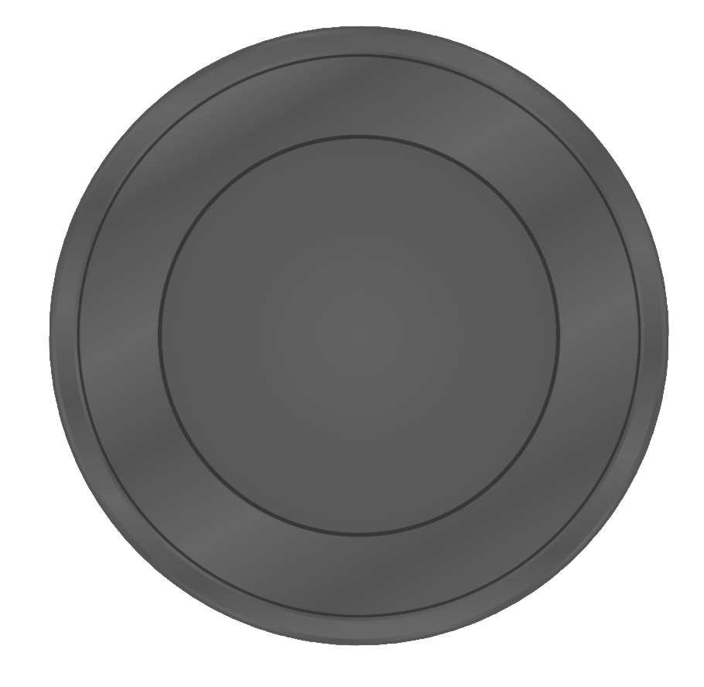
RoboRebound inspiration: Arcades
Add coins to arcade game to extend play time

Slide 11
Key idea #1: Bounded-time interaction
Each robot is periodically audited by neighbors
$f + 1$ unique tokens to be periodically obtained from successful audits

Slide 12
Key idea #1: Bounded-time interaction
Each robot is periodically audited by neighbors
$f + 1$ unique tokens to be periodically obtained from successful audits

Slide 13
Key idea #1: Bounded-time interaction
Each robot is periodically audited by neighbors
$f + 1$ unique tokens to be periodically obtained from successful audits

Slide 14
Key idea #1: Bounded-time interaction
Each robot is periodically audited by neighbors
$f + 1$ unique tokens to be periodically obtained from successful audits

Slide 15
Key idea #1: Bounded-time interaction
Each robot is periodically audited by neighbors
$f + 1$ unique tokens to be periodically obtained from successful audits

Slide 16
Key idea #1: Bounded-time interaction
Each robot is periodically audited by neighbors
$f + 1$ unique tokens to be periodically obtained from successful audits

Slide 17
Key idea #1: Bounded-time interaction
Each robot is periodically audited by neighbors
$f + 1$ unique tokens to be periodically obtained from successful audits

Slide 18
Key idea #1: Bounded-time interaction
Each robot is periodically audited by neighbors
$f + 1$ unique tokens to be periodically obtained from successful audits

Slide 19
Key idea #1: Bounded-time interaction
Each robot is periodically audited by neighbors
$f + 1$ unique tokens to be periodically obtained from successful audits

Slide 20
Key idea #1: Bounded-time interaction
Each robot is periodically audited by neighbors
$f + 1$ unique tokens to be periodically obtained from successful audits

Slide 21
Key idea #1: Bounded-time interaction
Each robot is periodically audited by neighbors
$f + 1$ unique tokens to be periodically obtained from successful audits
Game
Over

Slide 22
Key Idea #2: A little trust for tamper-evident logging
Each robot's computing architecture has:
Two small trusted nodes ("sensing" and "actuating")
One large, untrusted node
Sensor
Sensor Node
Compute Node
Actuator Node
Actuator

Slide 23
Key Idea #2: A little trust for tamper-evident logging
Each robot's computing architecture has:
Two small trusted nodes ("sensing" and "actuating")
One large, untrusted node
Sensor
Sensor Node
Compute Node
Actuator Node
Actuator

Slide 24
Components of RoboRebound
Trusted nodes maintain a hash chain to verify message correctness, existence, and ordering
Trusted nodes provide cryptographically verifiable authenticator to prevent forging of hash chains
All audit requests must include authenticators from trusted nodes
Auditors perform deterministic replay of tamper-evident logs
Successful audits result in auditor issuing a token (robots need $f+1$ tokens)

Slide 25
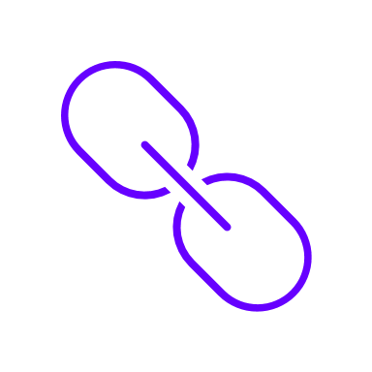
Data Flow
Actuator
Sensor
Sensor Node
Compute Node
Actuator Node
Radio
Log
Remote Robot
Hash Chain
Authenticator

Slide 26
Data Flow
Actuator
Sensor
Sensor Node
Compute Node
Actuator Node
Radio
Log
Hash Chain
Remote Robot
Authenticator
Token

Slide 27
Outline
Problem & Challenges
Solution Sketch
Design
Evaluation

Slide 28
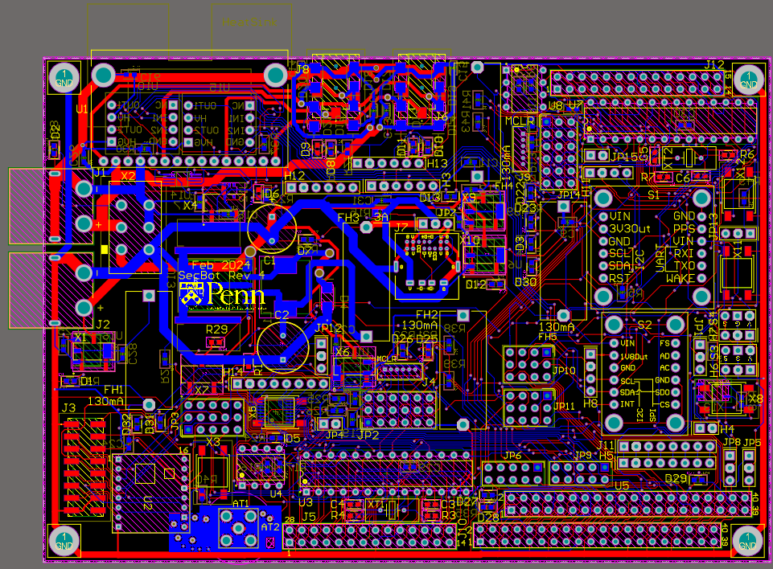
Implementation
Simulator in Network Simulator 3 (ns-3)
End-to-end and scalability experiments
SecBot hardware platform
Untrusted node: 4-core TinkerBoard S
Trusted nodes: 1-core PIC32
Used for microbenchmarks

Slide 29
Evaluation Questions
Will tiny, trusted nodes work in real hardware?
- Microbenchmark: CPU Utilization
- Microbenchmark: IO Overhead
What are the costs of RoboRebound?
Bandwidth & storage as functions of:
- Number of faults
- Time-bound for Bounded-Time Interaction
How effective is RoboRebound?
Case study
How does RoboRebound scale?
Bandwidth & storage as functions of:
- Number of robots
- Robot spatial density

Slide 30
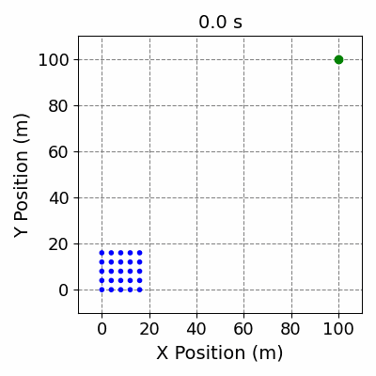
Case study: One compromised robot among 25
No Attack
No Defense
Defended

Slide 31
Overheads in real hardware
Benchmarked SHA-1 & LightMAC on PIC32 microcontroller @ 50MHz
$Δt_{rec}$ = 4s
Wireless state exchange T = 1.5s
Control period T = 0.25s
$f=3$
Each robot has ten neighbors
Sensor node core utilization: 5.99%
Actuator node core utilization: 17.28%
Computational overhead is manageable, even on resource-limited embedded systems.

Slide 32
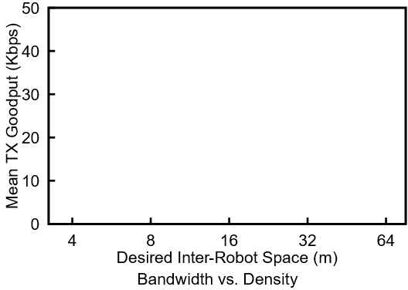
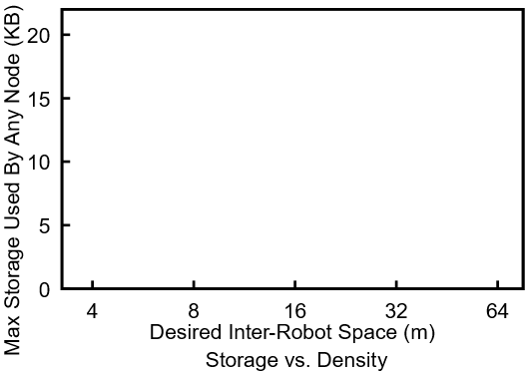
Scalability as a function of density
Higher density = More neighbors to track
Scales indefinitely at low enough density
16 Robots
64 Robots
16 Robots
64 Robots
36 Robots
100 Robots
36 Robots
100 Robots
Greater spatial density
Greater spatial density

Slide 33
Conclusion
Problem: Handling faults in MRS requires dealing with the ‘physical’ part of cyber-physical systems and network dynamism + unreliability
Goal: Return a multi-robot system to correct behavior within bounded time
Approach: Bounded-time interaction (BTI)
RoboRebound provides BTI from faults in robots in a dynamic, unreliable network
Requires adding two small trusted nodes to make actions auditable
Robots need to acquire tokens from auditors to continue operating
SecBot is the first BTI-enabled hardware platform
Evaluation: SecBot & ns-3 simulator
SecBot: Microcontrollers can handle BTI load
ns-3: Overall overheads are manageable, even at scale
Thank you!

Slide 34
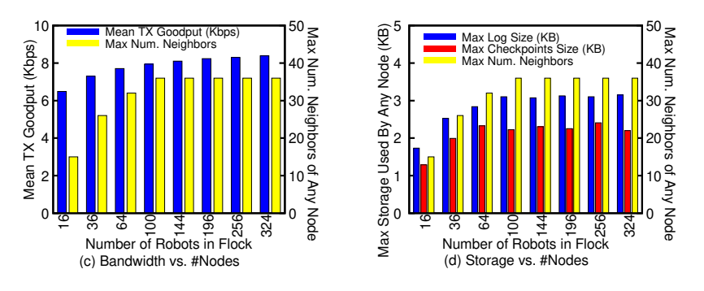
BW + Storage as functions of flock size

Slide 35
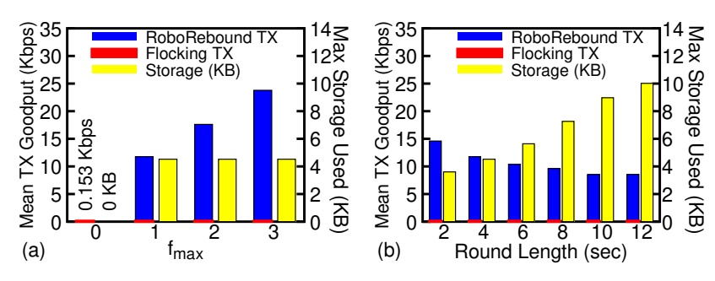
BW + Storage as functions of f_max, round length

Slide 36
Assumptions
Network is dynamic and unreliable
Inter-robot space large enough that a crash will not happen in the safe time bound $T$
Lightweight cryptography is usable (Hash, MAC)
Adversary cannot modify circuit boards in robots

Slide 37
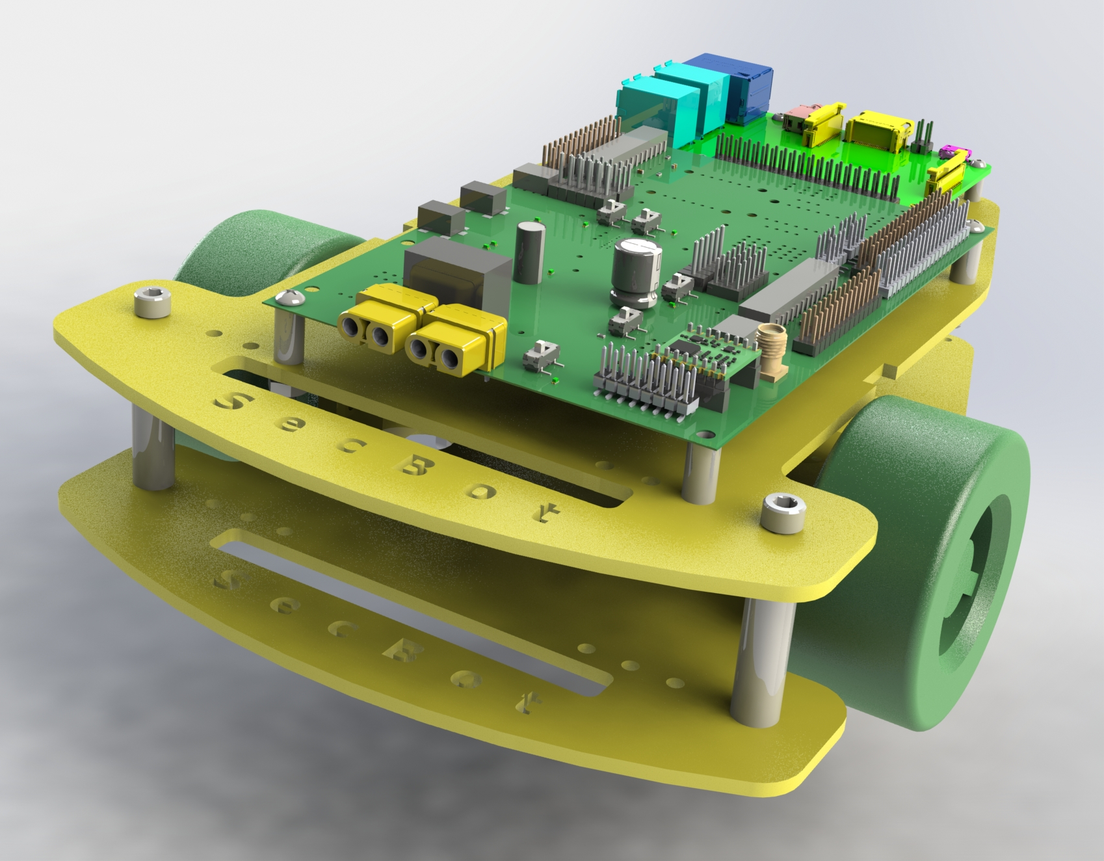
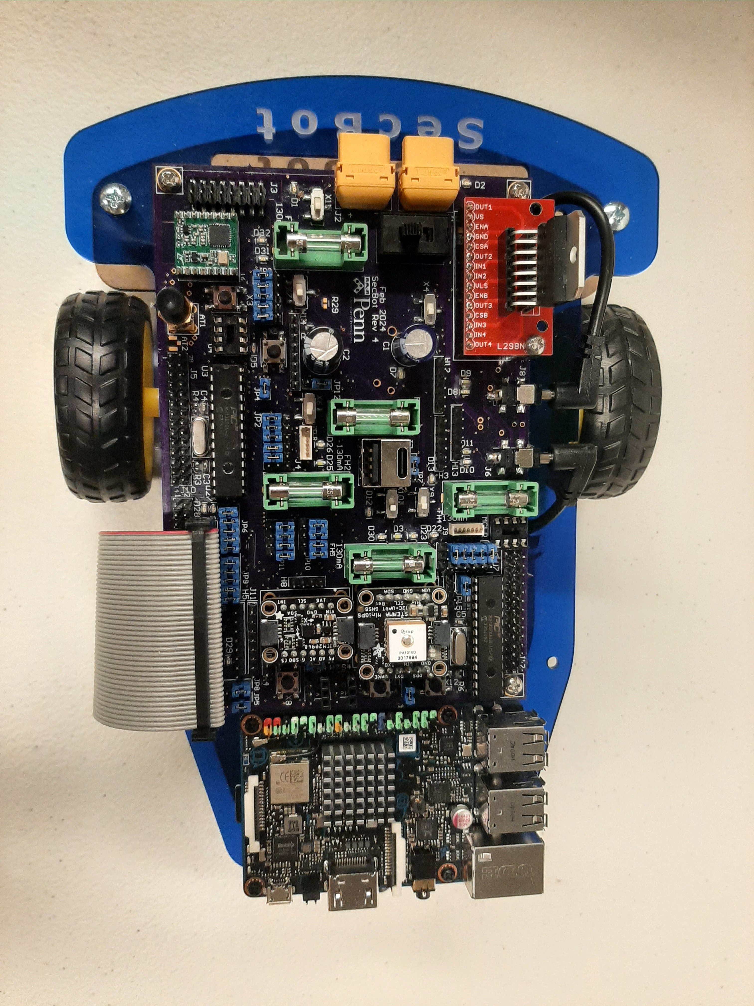
Implementation: SecBot
Designed a BTI-capable robot for robotics research
4-core TinkerBoard S as the untrusted, complex node
1-core PIC32 microcontrollers for trusted nodes

Slide 38
Implementation: SecBot Circuit Board
Two DC motors
Four sensors:
GNSS, IMU, 2 Encoders
Integrated radio
BTI option
Optional EEPROMs
Motor Driver & Opto-Isolators
Motor Connectors
EEPROM
Sensor Node
Battery
Conn.
Optional Common Ground
Power Distribution & Regulation
GNSS
IMU
Enc
Radio
EEPROM
Actuator Node
Antenna
TinkerBoard Connector

Slide 39
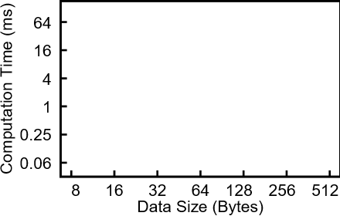
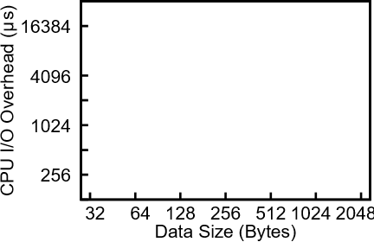
SecBot Microbenchmarks: Runtime & IO
Hash: SHA1, MAC: LightMAC
We can use these microbenchmarks to extrapolate total overheads for running a BTI system
SHA-1
Input
LightMAC
Output
$Δt_{rec}$ = 4s
Wireless state exchange T = 1.5s
Control period T = 0.25s
$f=3$
Each robot has ten neighbors
Sensor Node Core Utilization: 5.99%
Actuator Node Core Utilization: 17.28%

